Slide 1
Chapter 9
Reducing Project Duration

Slide 2
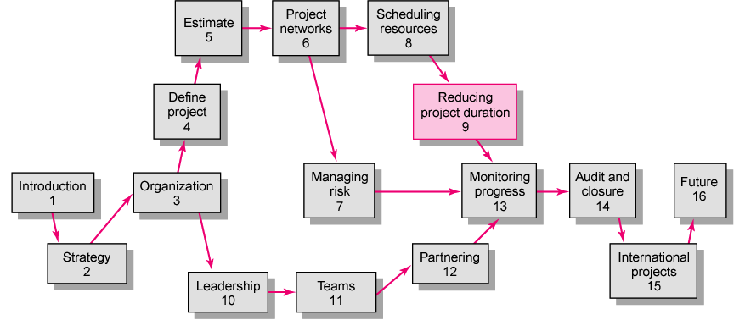

Slide 3
Rationale for Reducing Project Duration
Time Is Money: Cost-Time Tradeoffs
  Reducing the time of a critical activity usually incurs additional direct costs.
    Cost-time solutions focus on reducing (crashing) activities on the critical path to shorten overall duration of the project.
  Reasons for imposed project duration dates:
    Customer requirements and contract commitments
    Time-to-market pressures
    Incentive contracts (bonuses for early completion)
    Unforeseen delays
    Overhead and goodwill costs
    Pressure to move resources to other projects

Slide 4

Options for Accelerating Project Completion
Adding Resources
Outsourcing Project Work
Scheduling Overtime
Establishing a Core Project Team
Do It Twice—Fast and Correctly
Fast-Tracking
Critical-Chain
Reducing Project Scope
Compromise Quality

Slide 5
Explanation of Project Costs
Project Indirect Costs
  Costs that cannot be associated with any particular work package or project activity.
    Supervision, administration, consultants, and interest
  Costs that vary (increase) with time.
    Reducing project time directly reduces indirect costs.
Direct Costs
  Normal costs that can be assigned directly to a specific work package or project activity.
    Labor, materials, equipment, and subcontractors
  Crashing activities increases direct costs.

Slide 6
Reducing Project Duration to Reduce Project Cost
Identifying direct costs to reduce project time
Gather information about direct and indirect costs of specific project durations.
Search critical activities for lowest direct-cost activities to shorten project duration.
Compute total costs for specific durations and compare to benefits of reducing project time.

Slide 7
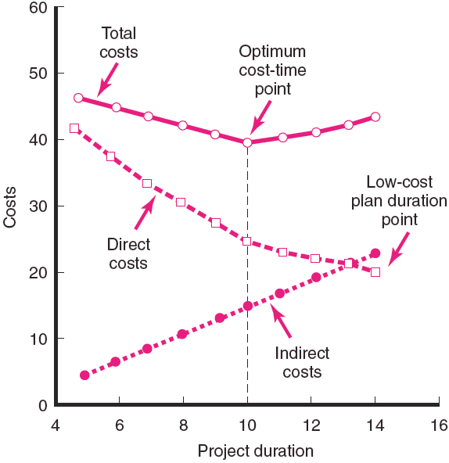
Project Cost—Duration Graph
FIGURE 9.1

Slide 8
Constructing a Project Cost—Duration Graph
Find total direct costs for selected project durations.
Find total indirect costs for selected project durations.
Sum direct and indirect costs for these selected project durations.
Compare additional cost alternatives for benefits.

Slide 9
Constructing a Project Cost—Duration Graph
Determining Activities to Shorten
  Shorten the activities with the smallest increase in cost per unit of time.
  Assumptions:
    The cost relationship is linear.
    Normal time assumes low-cost, efficient methods to complete the activity.
    Crash time represents a limit—the greatest time reduction possible under realistic conditions.
    Slope represents a constant cost per unit of time.
    All accelerations must occur within the normal and crash times.

Slide 10
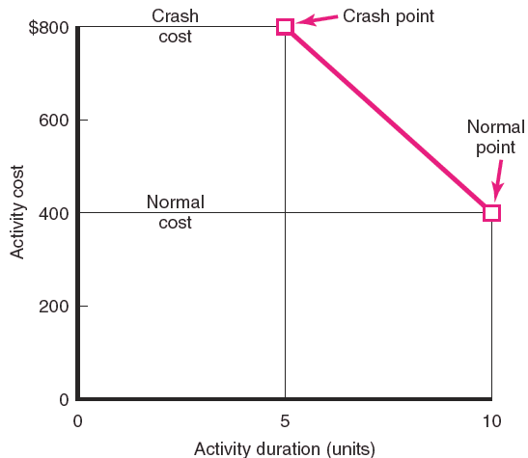
Activity Graph
FIGURE 9.2

Slide 11
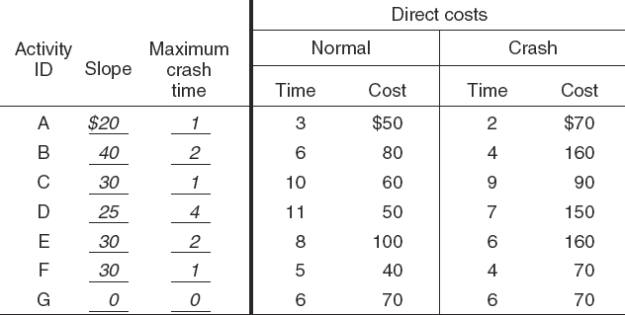
Cost—Duration Trade-off Example
FIGURE 9.3

Slide 12
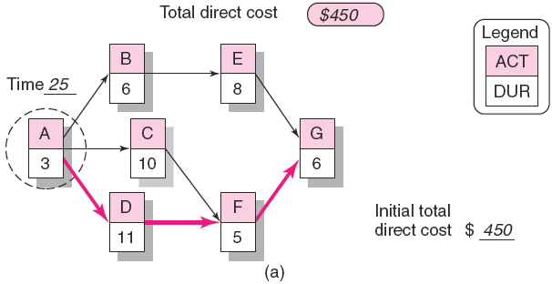
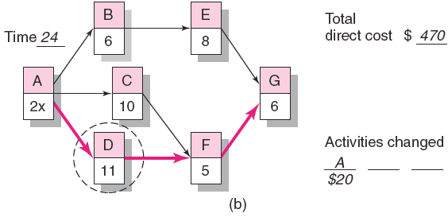
Cost—Duration Trade-off Example (cont’d)
FIGURE 9.3 (cont’d)

Slide 13
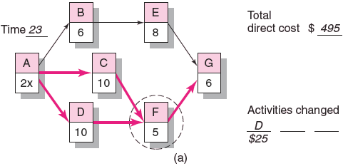
Cost—Duration Trade-off Example (cont’d)
FIGURE 9.4 (cont’d)

Slide 14
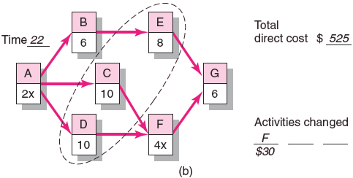
Cost—Duration Trade-off Example (cont’d)
FIGURE 9.4 (cont’d)

Slide 15
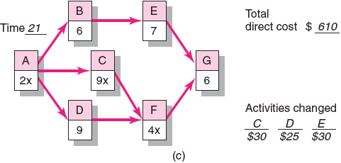
Cost—Duration Trade-off Example (cont’d)
FIGURE 9.4 (cont’d)

Slide 16
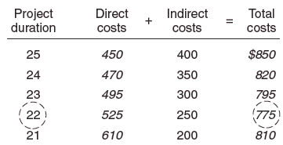
Summary Costs by Duration
FIGURE 9.5

Slide 17
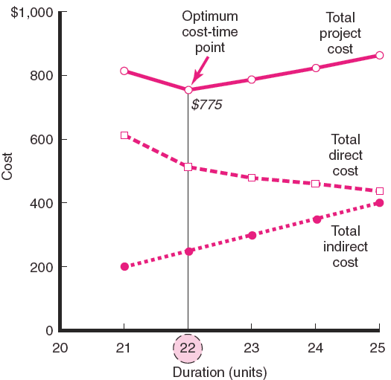
Project Cost—Duration Graph
FIGURE 9.6

Slide 18
Practical Considerations
Using the Project Cost—Duration Graph
Crash Times
Linearity Assumption
Choice of Activities to Crash Revisited
Time Reduction Decisions and Sensitivity

Slide 19
What if Cost, Not Time is the Issue?
Commonly Used Options for Cutting Costs
  Reduce project scope
  Have owner take on more responsibility
  Outsourcing project activities or even the entire project
  Brainstorming cost savings options

Slide 20
Key Terms
Crash point
Crash time
Direct costs
Fast-tracking
Indirect costs
Outsourcing
Phase project delivery
Project cost–duration graph

